Slide 1
Smart Restaurant Food Ordering Menu using Beaglebone Black
Group Members:- Amit Kumar (C0772515)
Ashok Kumar(C0762216)
Komalpreet Kaur(C0765526)
Ramandeep Kaur(C0772741)
Sagar Pasricha(C0765531)
Virender Singh(C0762540)

Slide 2
Interfacing LCD Display with beaglebone wireless at Receiver side
Presented by:-
Virender Singh
(C0762540)

Slide 3
Objective
1:- Introduction of LCD
2:- Pin configuration of LCD
3:- Interfacing with Beaglebone Wireless
4:- Coding
5:- Output
6:- Refrences

Slide 4
Required Components
1:- LCD
2:- Jumper wires
3:- Resistors
4:- Potentiometer
5:- Beaglebone Black Wireless
6:- PC
7:- Resistor (220 Ohms)

Slide 5
Introduction of LCD
LCD stands for Liquid Crystal Display. It is basically a screen that is used as an electric display module which has various range of applications. Most commonly used module is 16*2 LCD display and it is used in various devices and circuits. But we are using 20*4 LCD Display for this project. These modules are preferred over seven segments and other multi segment LEDs. It is basically available in electronic visible display, video display and flat panel display.

Slide 6
Inroduction to 20*4 LCD Module
In 20*4 LCD Module, there are 4 rows in display and in one row twenty character can be displayed and in one display eighty characters can be shown.
This liquid crystal module uses HDD44780 paralle interfacing.
The liquid crystal display interfacing code is easily accessible. We just required eleven input and output pinouts for the interfacing of LCD screen.
LCD works on two types of signal, first one is data and second one is for control.

Slide 7
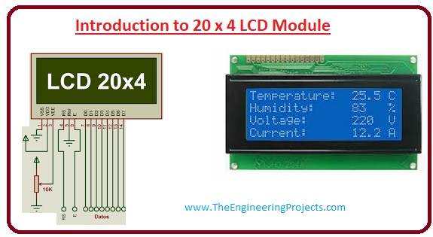
Layout Diagram of 20*4 LCD Pinout

Slide 8
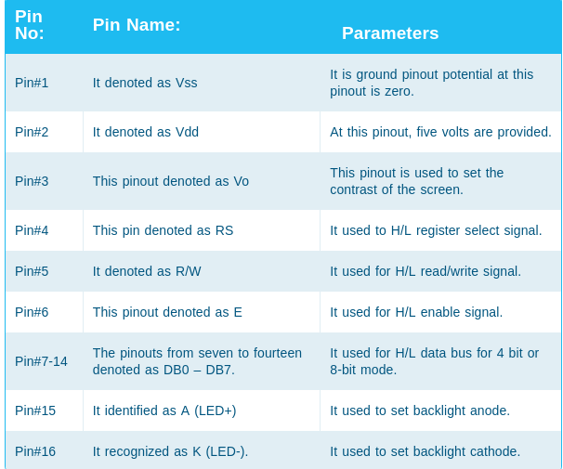
Pinouts of 20*4 LCD Modules

Slide 9
Features of 20*4 LCD
The most important feature is that it can display 80 characters at atime.
This module operates on +5 volts input supply and can also work on the +3 volts.
The +3 volts pinout can also be used for the negative supply.
The duty cycle of this module is 1/16.
Moreover there has been already assembled the controller of KW1063.

Slide 10
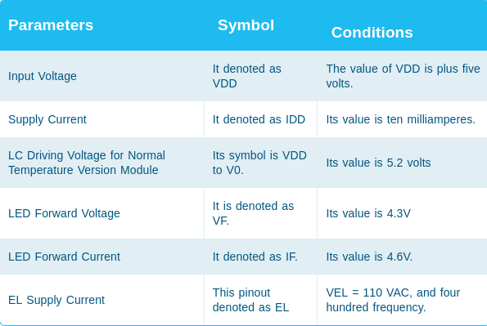
Electrical characteristics of 20*4 LCD

Slide 11
Advantages of 20*4 LCD
It is less expensive, lightweight as compared to the cathode ray tube display.
It uses less power according to the brightness resolution.
It produces less amount of heat due to less use of power.
It can be constructed in any shape and size according to user requirements.
The LCD used in the computer monitor uses 12 volts.

Slide 12
Interfacing with Beaglebone Black Wireless
For the interfacing part we are using GPIO pins. GPIO stands for General Purpose Input and output pins is an uncommitted digital signal pin on an integrated circuit or electronic circuit board which may be used as an input or output or both and is controllable by the user at runtime. They have no predefined purpose and are unused by default and if used, the purpose and behavior of a GPIO is defined and implemented by the designer of higher assembly level circuitry.

Slide 13
Types of GPIO Pins
1:- Integrated Circuit GPIO:- They provide primary function to some IC whereas other include GPIOs as convenient accessory to some other primary function. Microcontroller IC usually include GPIOs.
2:- Board Level GPIOs:- Like IC based GPIOs, some boards merely include GPIOs as a convenient, auxillary resource that augments the boards primary function, whereas in other boards the GPIOs are the central,primary function of the board.

Slide 14
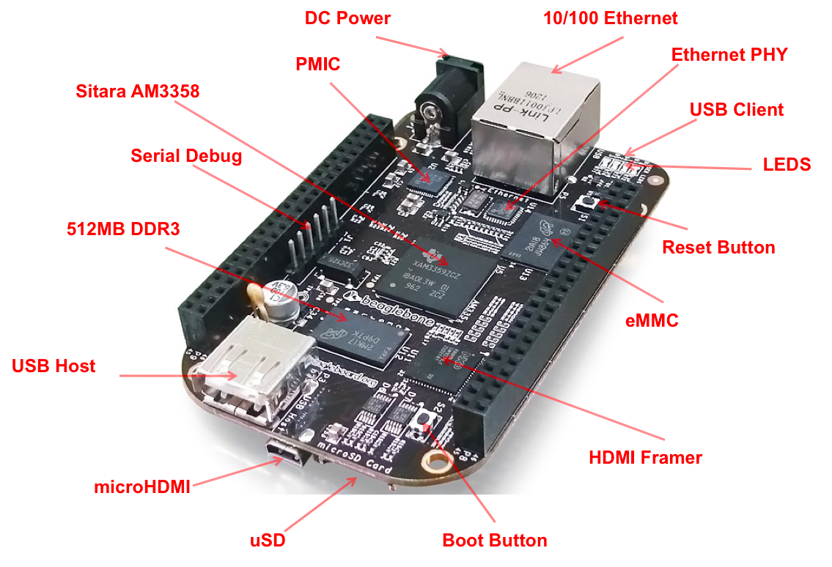
Diagram of GPIO Pins

Slide 15
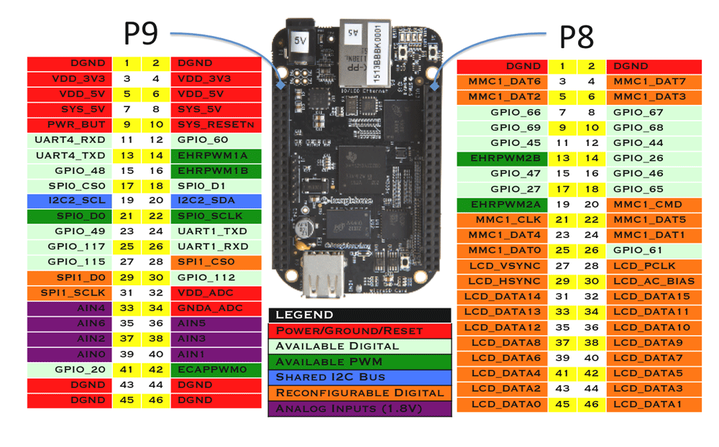
Pin configuration of GPIO Pins

Slide 16
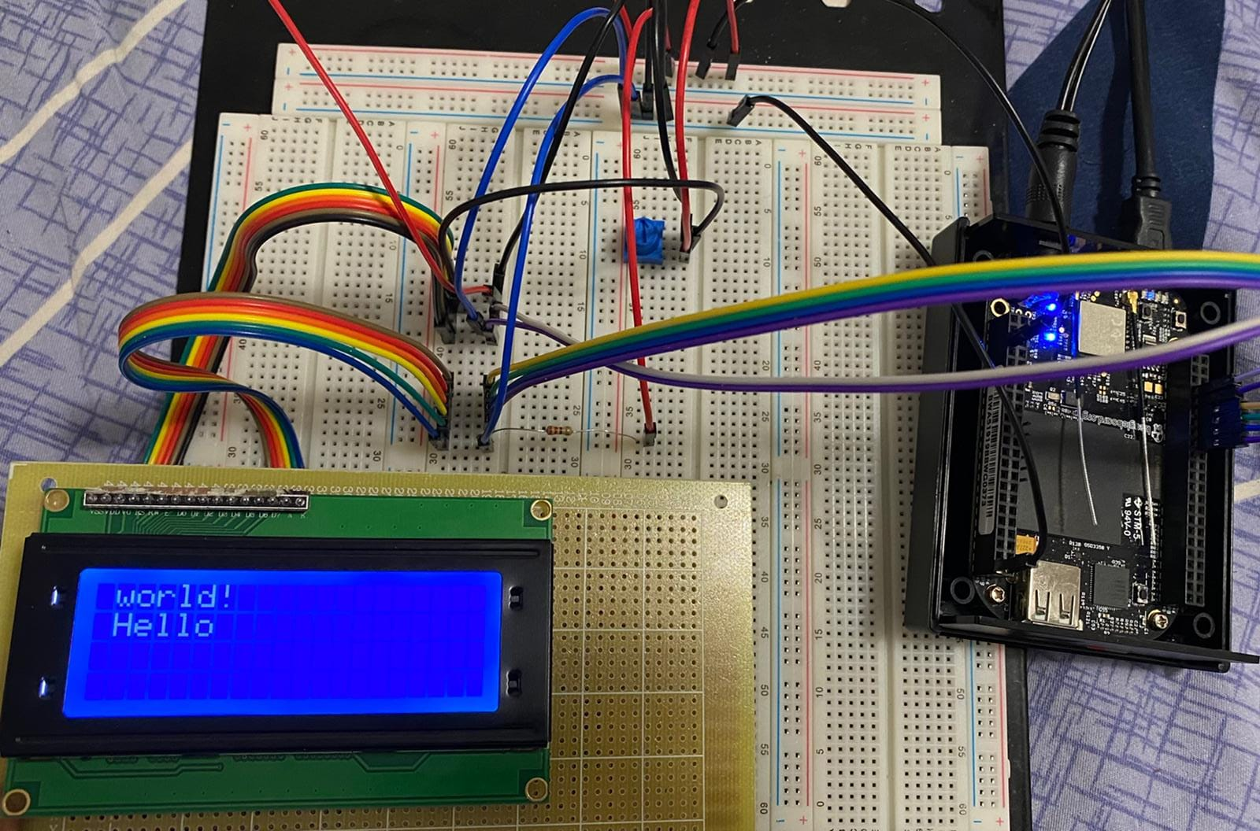
LCD connection with Breadboard and Beaglebone Black

Slide 17
Coding
#include<iostream>
#include<sstream>
#include<fstream>
#include<cstring>
#include<unistd.h>
using namespace std;

Slide 18
Coding
#define LCD_CLEARDISPLAY 0x01
#define LCD_RETURNHOME 0x02
#define LCD_ENTRYMODESET 0x04
#define LCD_DISPLAYCONTROL 0x08
#define LCD_CURSORSHIFT 0x10
#define LCD_FUNCTIONSET 0x20
#define LCD_SETCGRAMADDR 0x40
#define LCD_SETDDRAMADDR 0x80

Slide 19
Coding
//Entry flags
#define LCD_ENTRYRIGHT 0x00
#define LCD_ENTRYLEFT 0x02
#define LCD_ENTRYSHIFTINCREMENT 0x01
#define LCD_ENTRYSHIFTDECREMENT 0x00
//Control flags
#define LCD_DISPLAYON 0x04
#define LCD_DISPLAYOFF 0x00
#define LCD_CURSORON 0x02
#define LCD_CURSOROFF 0x00
#define LCD_BLINKON 0x01
#define LCD_BLINKOFF 0x00

Slide 20
Coding
/Move flags
#define LCD_DISPLAYMOVE 0x08
#define LCD_CURSORMOVE 0x00
#define LCD_MOVERIGHT 0x04
#define LCD_MOVELEFT 0x00
//Function set flags
#define LCD_8BITMODE 0x10
#define LCD_4BITMODE 0x00
#define LCD_2LINE 0x08
#define LCD_1LINE 0x00
#define LCD_5x10DOTS 0x04
#define LCD_5x8DOTS 0x00
//Offset for up to 4 rows.
int LCD_ROW_OFFSETS[]= {0x00, 0x40, 0x14, 0x54};

Slide 21
Coding
//Char LCD plate GPIO numbers.
#define LCD_PLATE_RS 15
#define LCD_PLATE_RW 14
#define LCD_PLATE_EN 13
#define LCD_PLATE_D4 12
#define LCD_PLATE_D5 11
#define LCD_PLATE_D6 10
#define LCD_PLATE_D7 9
#define LCD_PLATE_RED 6
#define LCD_PLATE_GREEN 7
#define LCD_PLATE_BLUE 8

Slide 22
Coding
//Char LCD plate button names.
#define SELECT 0
#define RIGHT 1
#define DOWN 2
#define UP 3
#define LEFT 4

Slide 23
Coding
class LiquidCrystal{
private:
int _cols, _lines, _rs, _en, _d4, _d5, _d6, _d7, display_control, display_function, display_mode, _backlight;
ostringstream out_string;
string PATH = "/sys/class/gpio/gpio";
fstream fd;
public:
void pinSetup(int pinNumber){
out_string << pinNumber;
string newS=PATH+out_string.str();
out_string.str("");
out_string.clear();
fd.open(newS+"/direction");
fd << "out";
fd.close();
}

Slide 24
Coding
void outputs(int pinNumber, int val){
out_string << pinNumber;
string newS=PATH+out_string.str();
out_string.str("");
out_string.clear();
out_string << val;
fd.open(newS+"/value");
fd << val;
out_string.str("");
out_string.clear();
fd.close();
}
void output(int pinNumber, bool logic){
out_string << pinNumber;
string newS=PATH+out_string.str();
out_string.str("");
out_string.clear();
out_string << int(logic);
fd.open(newS+"/value");
fd << int(logic);
out_string.str("");
out_string.clear();
fd.close();
}

Slide 25
Coding
void home(){
/* Move the cursor back to its home (first line and first column).*/
write8(LCD_RETURNHOME); // set cursor position to zero
_delay_microseconds(3000); // this command takes a long time!
}
void clear(){
/* Clear the LCD.*/
write8(LCD_CLEARDISPLAY); // command to clear display
_delay_microseconds(2000); // 3000 microsecond sleep, clearing the display takes a long time
}
void _delay_microseconds(float tim){
tim/=50000;
out_string << tim;
string cmd="sleep "+out_string.str();
out_string.str("");
out_string.clear();
system(cmd.c_str());
}

Slide 26
Coding
void set_cursor(int col, int row){
/* Move the cursor to an explicit column and row position. */
// Clamp row to the last row of the display.
if(row > _lines)
row = _lines - 1;
// Set location.
write8(LCD_SETDDRAMADDR | (col + LCD_ROW_OFFSETS[row]));
}
void enable_display(int enable){
/* Enable or disable the display. Set enable to True to enable.*/
if(enable)
display_control |= LCD_DISPLAYON;
else
display_control &= ~LCD_DISPLAYON;
write8(LCD_DISPLAYCONTROL | display_control);
}

Slide 27
Coding
void _pulse_enable(){
// Pulse the clock enable line off, on, off to send command.
output(_en, false);
_delay_microseconds(1); // 1 microsecond pause - enable pulse must be > 450ns
output(_en, true);
_delay_microseconds(1); // 1 microsecond pause - enable pulse must be > 450ns
output(_en, false);
_delay_microseconds(1);
}
void show_cursor(bool show){
/* Show or hide the cursor. Cursor is shown if show is True.*/
if(show)
display_control |= LCD_CURSORON;
else{
display_control &= ~LCD_CURSORON;
write8(LCD_DISPLAYCONTROL | display_control);
}
}

Slide 28
Coding
void blink(bool blink){
/* Turn on or off cursor blinking. Set blink to True to enable blinking.*/
if(blink)
display_control |= LCD_BLINKON;
else
display_control &= ~LCD_BLINKON;
write8(LCD_DISPLAYCONTROL | display_control);
}
void move_left(){
/* Move display left one position.*/
write8(LCD_CURSORSHIFT | LCD_DISPLAYMOVE | LCD_MOVELEFT);
}
void move_right(){
/* Move display right one position.*/
write8(LCD_CURSORSHIFT | LCD_DISPLAYMOVE | LCD_MOVERIGHT);
}

Slide 29
Coding
void set_left_to_right(){
/* Set text direction left to right.*/
display_mode |= LCD_ENTRYLEFT;
write8(LCD_ENTRYMODESET | display_mode);
}
void autoscroll(bool autoscroll){
/*Autoscroll will 'right justify' text from the cursor if set True,
otherwise it will 'left justify' the text.
*/
if(autoscroll)
display_mode |= LCD_ENTRYSHIFTINCREMENT;
else
display_mode &= ~LCD_ENTRYSHIFTINCREMENT;
write8(LCD_ENTRYMODESET | display_mode);
}
void set_left_to_right(){
/* Set text direction left to right.*/
display_mode |= LCD_ENTRYLEFT;
write8(LCD_ENTRYMODESET | display_mode);
}
void autoscroll(bool autoscroll){
/*Autoscroll will 'right justify' text from the cursor if set True,
otherwise it will 'left justify' the text.
*/
if(autoscroll)
display_mode |= LCD_ENTRYSHIFTINCREMENT;
else
display_mode &= ~LCD_ENTRYSHIFTINCREMENT;
write8(LCD_ENTRYMODESET | display_mode);
}

Slide 30
Coding
void message(string text){
/* Write text to display. Note that text can include newlines.*/
int line = 0;
// Iterate through each character.
for(int i: text){
// Advance to next line if character is a new line.
if(i == 10){
line += 1;
// Move to left or right side depending on text direction.
int col=0; if(display_mode & LCD_ENTRYLEFT > 0){} else _cols-1;
set_cursor(col, line);
}
// Write the character to the display.
else
write8(i, true);
}
}

Slide 31
Coding
void write8(int val, bool char_mode=false){
/*
Write 8-bit value in character or data mode. Value should be an int
value from 0-255, and char_mode is True if character data or False if
non-character data (default).
*/
_delay_microseconds(1000);
output(_rs, char_mode);
outputs(_d4,((val >> 4) & 1) > 0);
outputs(_d5,((val >> 5) & 1) > 0);
outputs(_d6,((val >> 6) & 1) > 0);
outputs(_d7,((val >> 7) & 1) > 0);
_pulse_enable();
outputs(_d4,(val & 1) > 0);
outputs(_d5,((val >> 1) & 1) > 0);
outputs(_d6,((val >> 2) & 1) > 0);
outputs(_d7,((val >> 3) & 1) > 0);
_pulse_enable();
}

Slide 32
Coding
LiquidCrystal(int rs, int en, int d4, int d5, int d6, int d7, int cols, int lines, int backlight=0){
_cols=cols;
_lines=lines;
_rs=rs;
_en=en;
_d4=d4;
_d5=d5;
_d6=d6;
_d7=d7;
_backlight=backlight;
pinSetup(rs);
pinSetup(en);
pinSetup(d4);
pinSetup(d5);
pinSetup(d6);
pinSetup(d7);
write8(0x33);
write8(0x32);
display_control = LCD_DISPLAYON | LCD_CURSOROFF | LCD_BLINKOFF;
display_function = LCD_4BITMODE | LCD_1LINE | LCD_2LINE | LCD_5x8DOTS;
display_mode = LCD_ENTRYLEFT | LCD_ENTRYSHIFTDECREMENT;

Slide 33
Coding
// write registers
write8(LCD_DISPLAYCONTROL | display_control);
write8(LCD_FUNCTIONSET | display_function);
write8(LCD_ENTRYMODESET | display_mode); // set the entry mode
clear();
}
~LiquidCrystal(){
}
};

Slide 34
Coding
int main(){
// BeagleBone Black configuration:
int lcd_rs = 67;
int lcd_en = 68;
int lcd_d4 = 44;
int lcd_d5 = 26;
int lcd_d6 = 46;
int lcd_d7 = 65;

Slide 35
Coding
// Define LCD column and row size for 16x2 LCD.
int lcd_columns = 20;
int lcd_rows = 4;
LiquidCrystal lcd(lcd_rs,lcd_en, lcd_d4, lcd_d5, lcd_d6, lcd_d7,lcd_columns, lcd_rows);
for (int i = 0; i < 5; i++)
{
lcd.set_cursor(1,0);
lcd.message("Item Quanity ");
lcd.set_cursor(1,1);
lcd.message("Pizza 1");
lcd.set_cursor(1,2);
lcd.message("Icecream 4");
lcd.set_cursor(1,3);
lcd.message("Burger 2");
lcd.set_cursor(1,4);
lcd.message("Juice 1 ");
// Wait 5 seconds
sleep(1);
}
return 0;
}

Slide 36
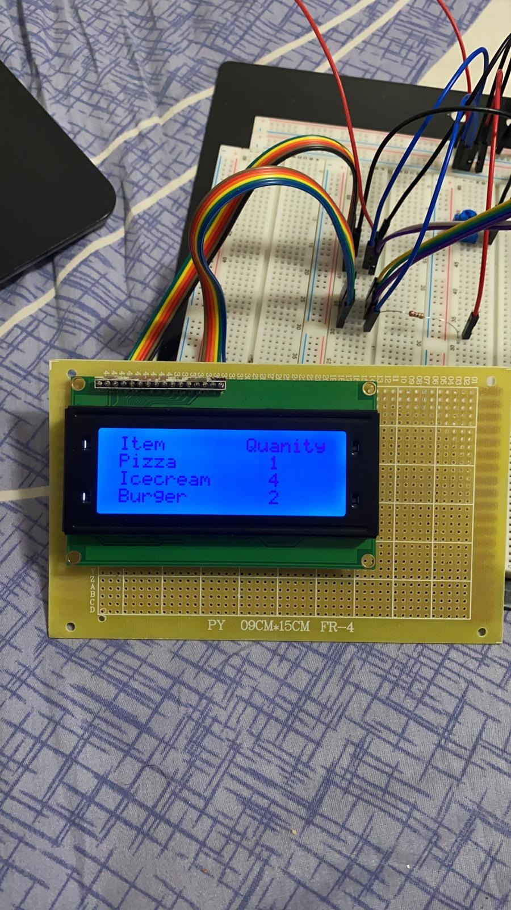
Final Display

Slide 37
Refrences
https://www.instructables.com/Basic-LCD-Project-Arduino-LCD-16x2-Display/
https://www.theengineeringprojects.com/2019/12/introduction-to-20-x-4-lcd-module.html
https://en.wikipedia.org/wiki/General-purpose_input/output
// http://web.alfredstate.edu/faculty/weimandn/lcd/lcd_addressing/lcd_addressing_index.html
// https://github.com/adafruit/Adafruit_Python_CharLCD/blob/master/Adafruit_CharLCD/Adafruit_CharLCD.py
// https://www.arduino.cc/en/Tutorial/LibraryExamples/HelloWorld

